Slide 1
GFRC FACADES
CREATING LANDMARKS WITH GRC
GRC AT ITS BEST - PROJECTS

Slide 2
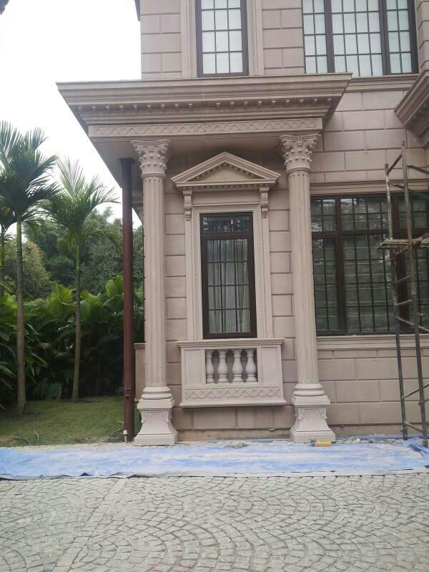
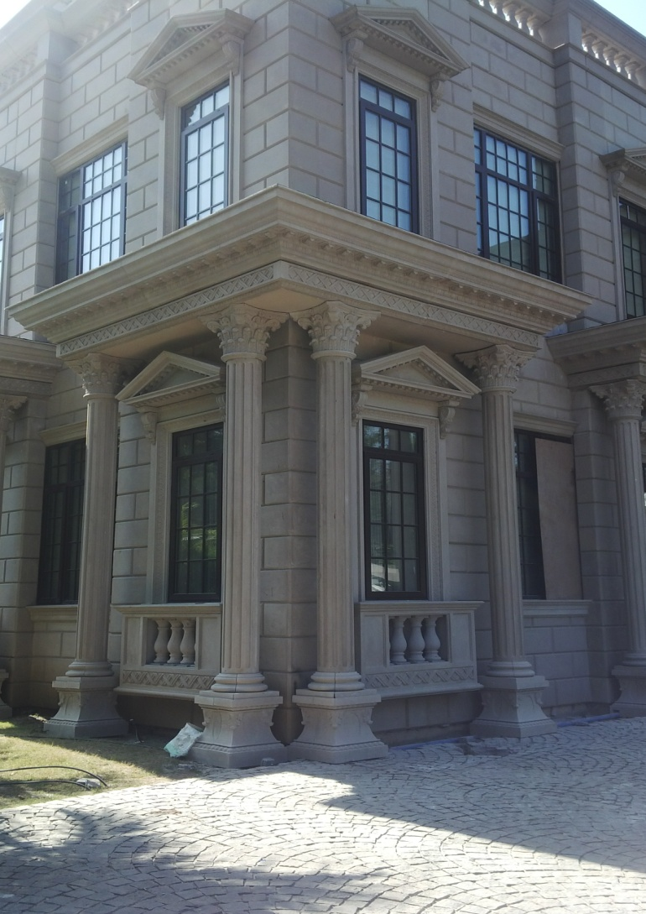
WINDOW SURROUNDS

Slide 3
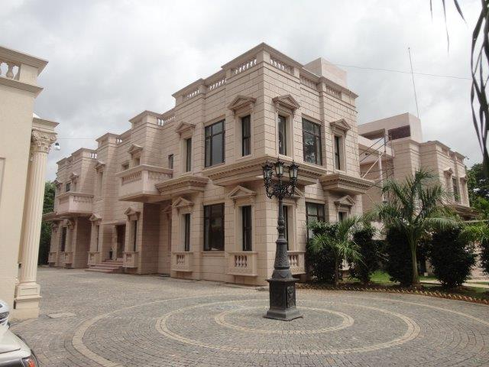
VILLA AT PUNE

Slide 4
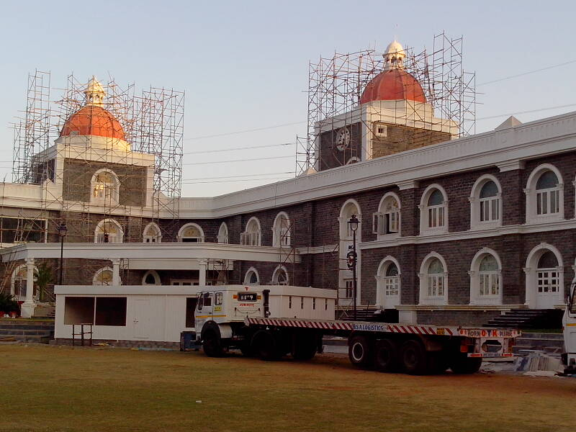
MCA CLUB HOUSE - MUMBAI

Slide 5
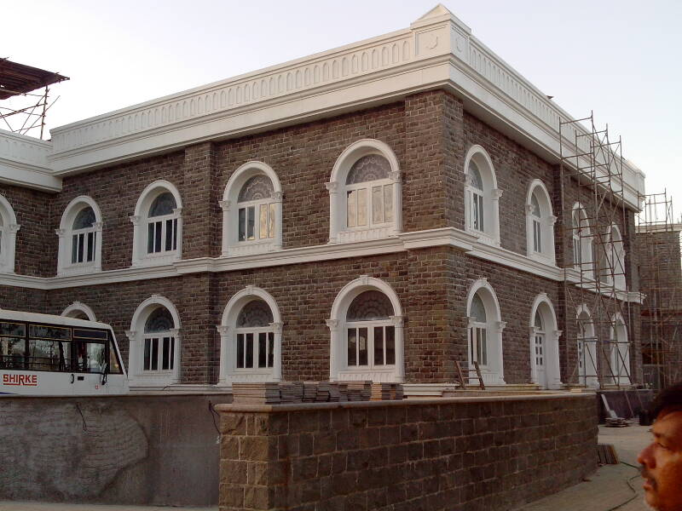
WINDOW SURROUNDS & CORNICE

Slide 6
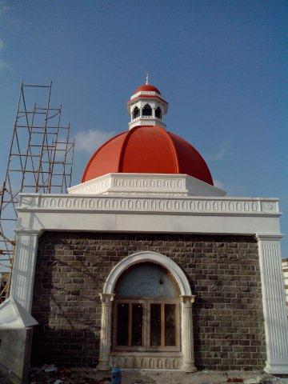
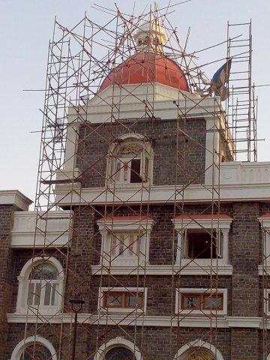
MCA CLUB HOUSE – MUMBAI
THE DOME

Slide 7
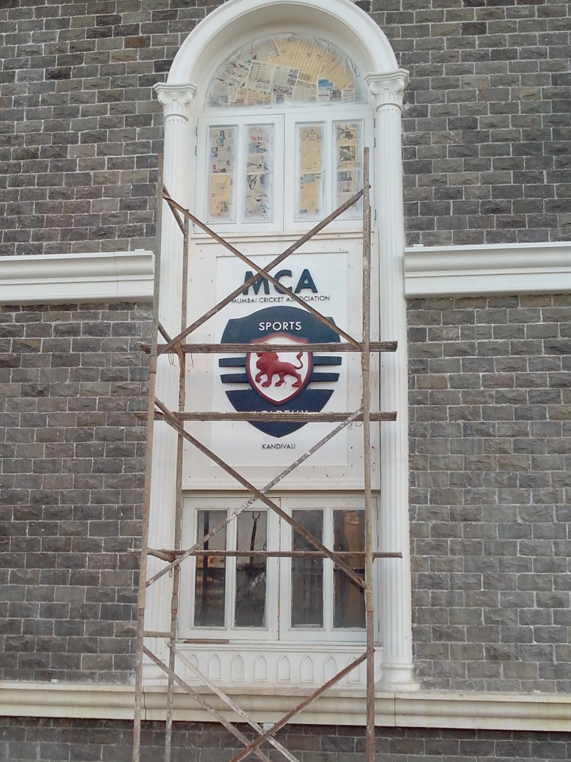

THE ARCH WINDOW SURROUND & THE LOGO

Slide 8
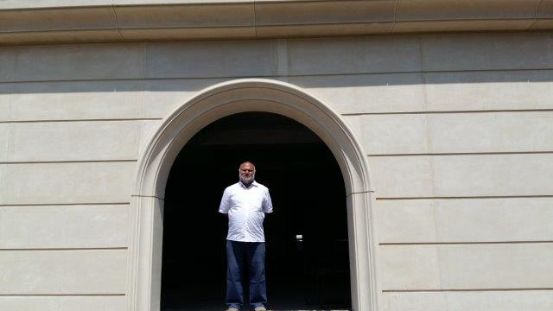
DOOR SURROUND

Slide 9
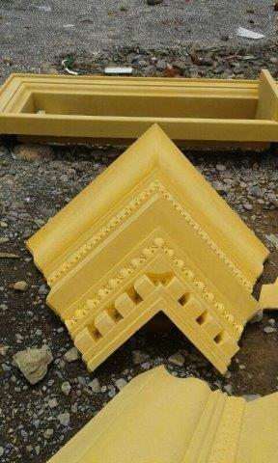
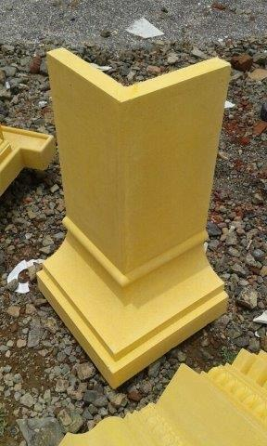
CORNERS OF CORNICE

Slide 10
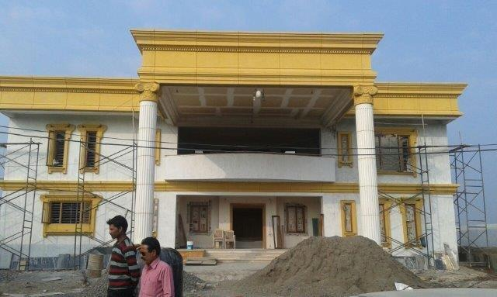
VILLA AT BEED – THE CORNICE

Slide 11
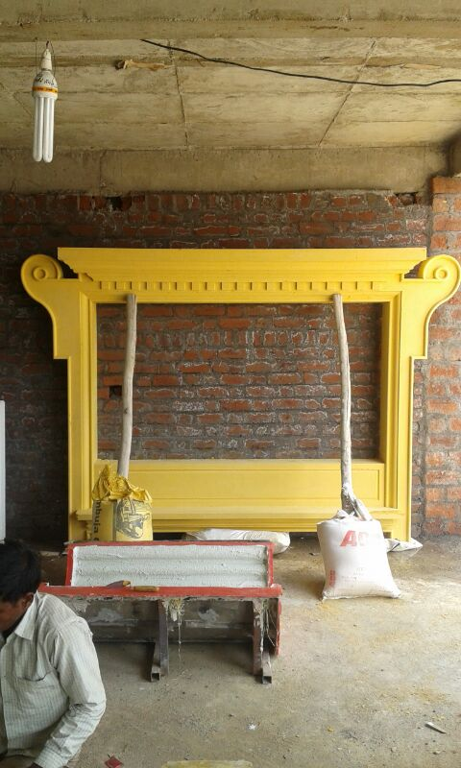
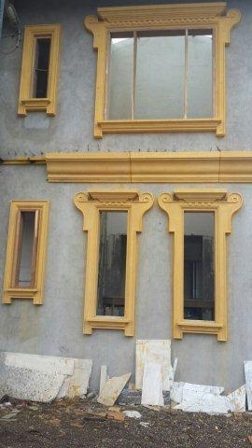
THE WINDOW SURROUND IN GRC

Slide 12
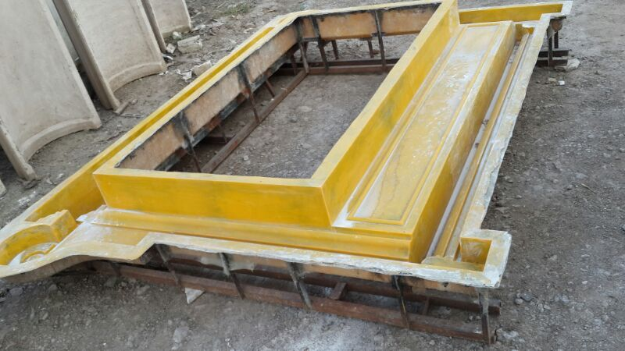
THE MOLD – WINDOW SURROUND

Slide 13
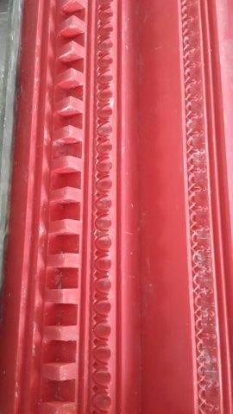
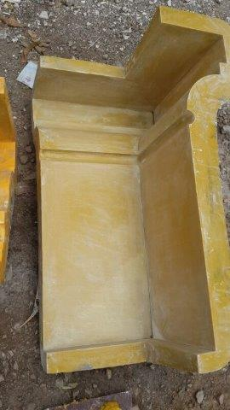
RUBBER MOULD - FIBRE MOULD

Slide 14
CONTACT DETAILS
GFRC FACADES.
GFRC / GRC, GRG CEILINGS & PANELS, FRP WORKS, HIGH END DECORATIVE & ARCHITECTURAL WORKS & ACOUSTIC SOLUTIONS WITH EXPERTISE IN HOME THEATRES
SRIHARI NILKAR
MUMBAI
Mobile: 09867569395
nilkarsrihari@gmail.com

